Slide 1
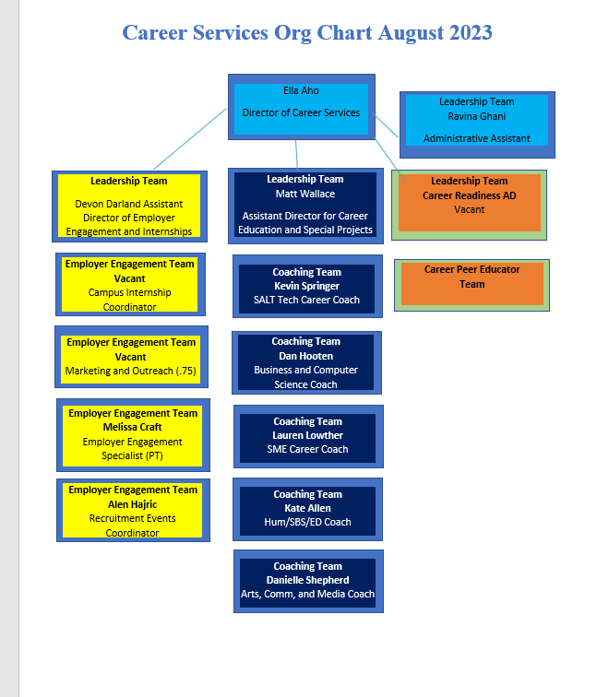
Org Chart as of August 2023

Slide 2
Campus Internship Program- Oversee student programming, supervisor training, job fairs, case management, budget-, Interim Devon: Vacant
CIP Coordiantor-Supervisor communication & Training
Team
Recruit CIP students & Supervisors
CIP Coordiantor
Student Programming
CIP Team
CIP Job Fairs
CIP Coordiantor
Budget
CIP Coordiantor
Termination & Hire Forms
CIP Coordiantor
Retention & data tracking
Team
CIP qualification forms
Ella, CIP Coordiantor, Devon
Yearly budget requests
Coaches
Case Management
Marketing

Slide 3
Case Management- CARES, COOP, Work-Study and CIP
Matt
Leads team and helps set vision
Matt
Serve on CARES team
Melissa
Work Study
Matt & Devon
Oversee FDS
CIP Coordiantor & Team
Oversee CIP retention
Career Readiness AD
Student Projects
Coaches
Stay on task of emailing students and tracking outcomes
Team
Overall success of the program!
Signal Vine lead
MySuccess lead

Slide 4
Employer Engagement-Oversee marketing, planning of the fair employer outreach, budget, programming, process, and assessment
Alen
Recruit Employers for Job Fairs and Showcases
Alen
Train employers on Handshake, CPT/OPT and PD
Alen
Oversee event registration & day of logistics
Alen & Devon
Job Fair/Showcase Vision
Melissa
Faculty outreach & breakfast events
Oversight of Budget
Devon and EE team
Oversee, programming, EE website, and marketing vision
Devon, Melissa, Alen
Oversight of Handshake on EE side
Team
Overall success of the program!
Devon & Alen

Slide 5
Marketing and Programming Leads
Devon
Employer Outreach Materials
Devon & Danielle
Employer Event materials
Devon & Danielle
EE Website
Danielle & Devon
Social Media campaigns
Danielle and Matt
Student programming materials
Student Website
Ella
Faculty & Staff Marketing
CIP Coordiantor
CIP student marketing, programming, recognition
Team!
Overall Success of branding.
Danielle and Career Readiness Coordiantor
Career Readiness AD
Student ppt slides, tabling materials and handouts
Canvas Course
CS Branding Boards
Fairs
Student employment

Slide 6
Supervising Team
Career Peer Educator
Outreach, coaching, walking-ins, social media, special projects, Career Closet, Career Blog, Programmin
Leadership Team
Devon, Matt, Ella, Ravina
Oversee budget, strategic plans, vision of retreats, career development plans, and staff meetings
Bridge between senior leadership and career team
Career Readiness Coordiantor- Supervisor

Slide 7
Liaison Expectations
Email contact to introduce yourself.
Find out what their top programs are and how you can support them
Marketing of events
Workshop request
Training requests
Meet once a semester
Notes:
https://slccbruins.sharepoint.com/:w:/r/sites/CareerServicesTeam/_layouts/15/Doc.aspx?sourcedoc=%7BFF4EE3DB-1424-42D8-BAD2-C263CA964FFF%7D&file=Liasion%20Assignments%202021.docx&action=default&mobileredirect=true

Slide 8
Liaison Policies and Sign-ups
Sign-Ups
Policies
Notes:
https://slccbruins.sharepoint.com/:w:/r/sites/CareerServicesTeam/_layouts/15/Doc.aspx?sourcedoc=%7BFF4EE3DB-1424-42D8-BAD2-C263CA964FFF%7D&file=Liasion%20Assignments%202021.docx&action=default&mobileredirect=true

